Slide 1
Project 3: Mars Cargo Mobility System
Team 30
Notes:
Video Presentation: https://www.youtube.com/watch?v=PAkueHlnwbQ

Slide 2
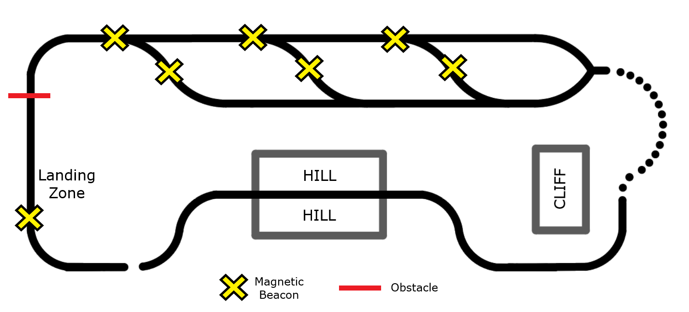
Project Goals and Objectives
Build a robot that could deliver cargo in a simulated Mars environment
Line following
Obstacles
Cargo delivery
Speed

Slide 3
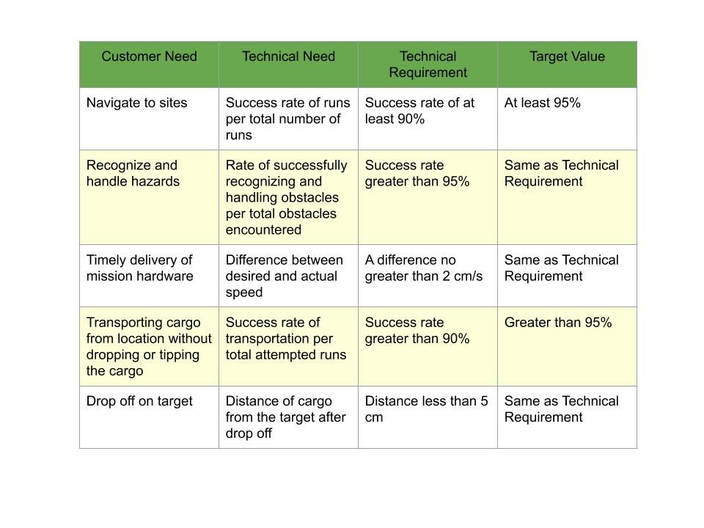

Slide 4
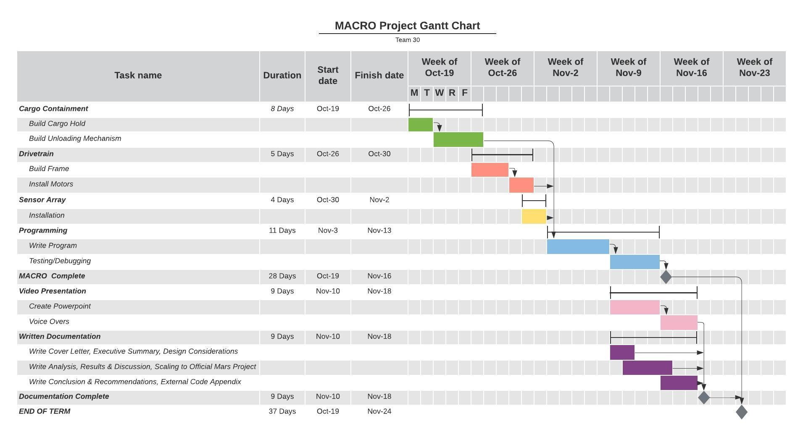

Slide 5
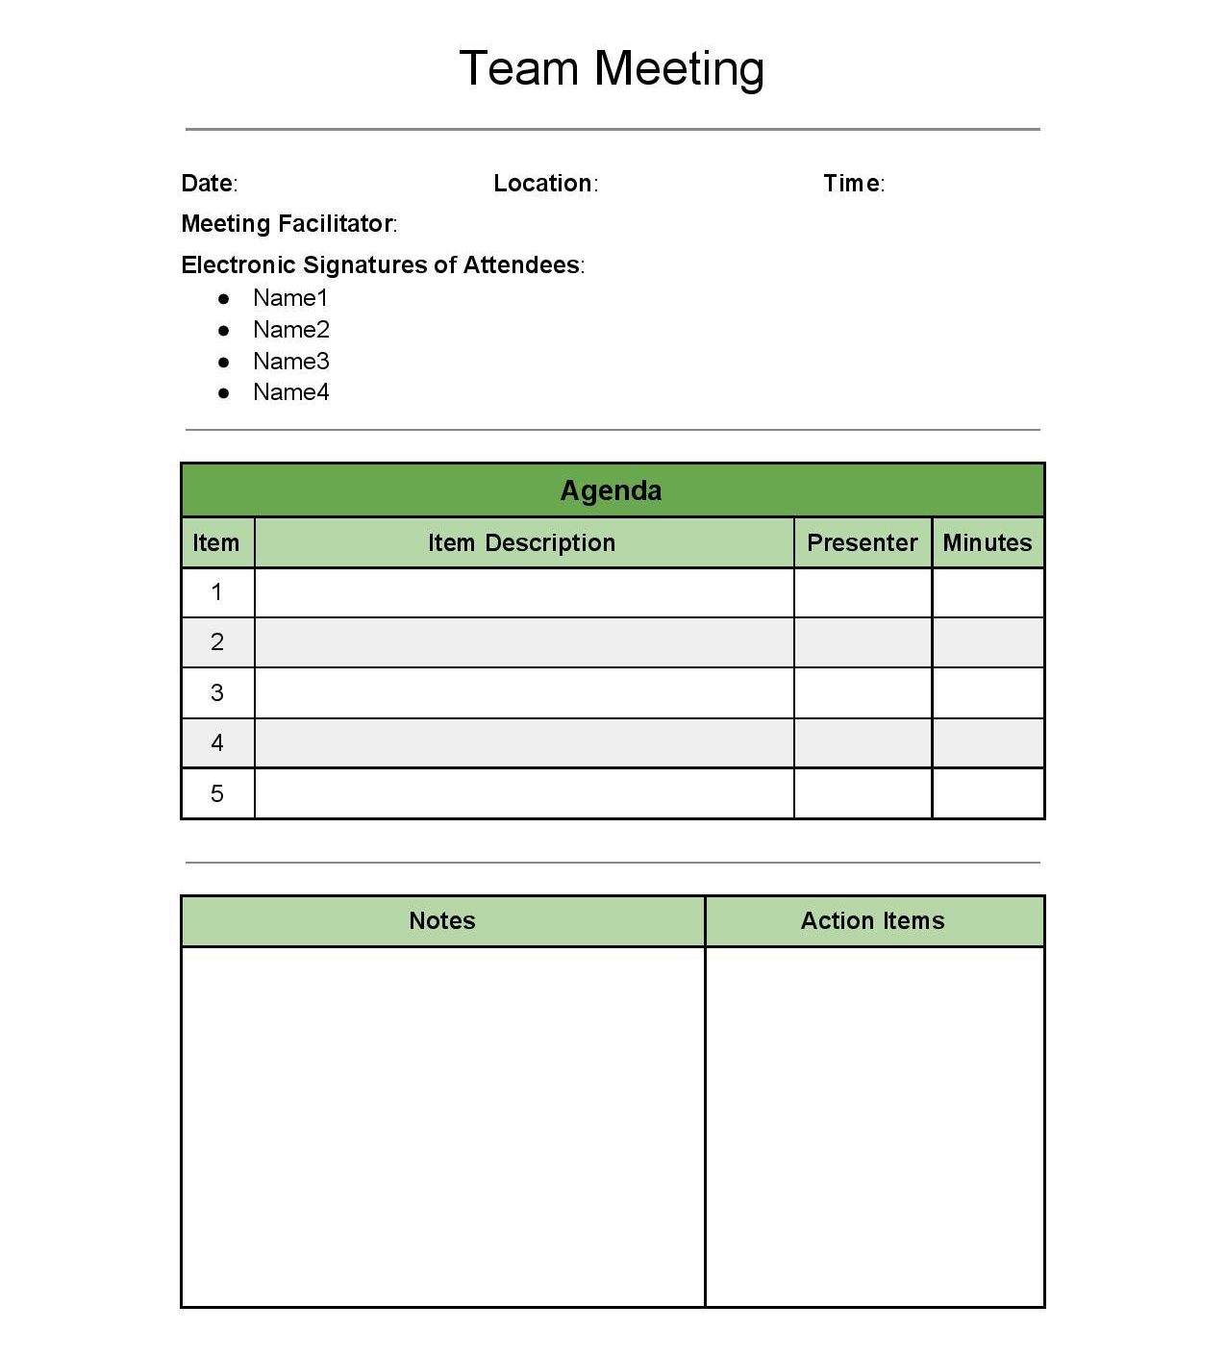

Slide 6
Design Philosophy (Mechanics)
Cargo Containment
Unloading Mechanism
Drivetrain
Sensors

Slide 7
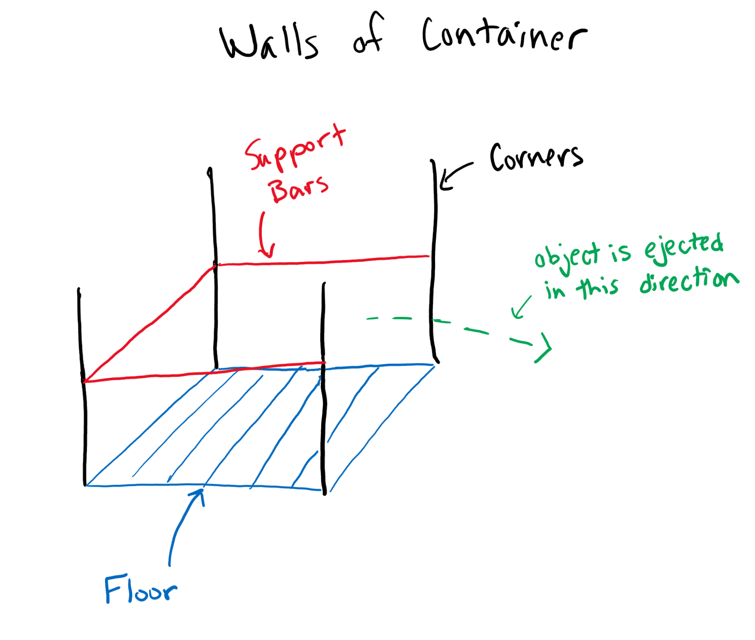
Cargo Container
Bars on the sides
Solid platform on bottom
Can hold any type of cargo

Slide 8
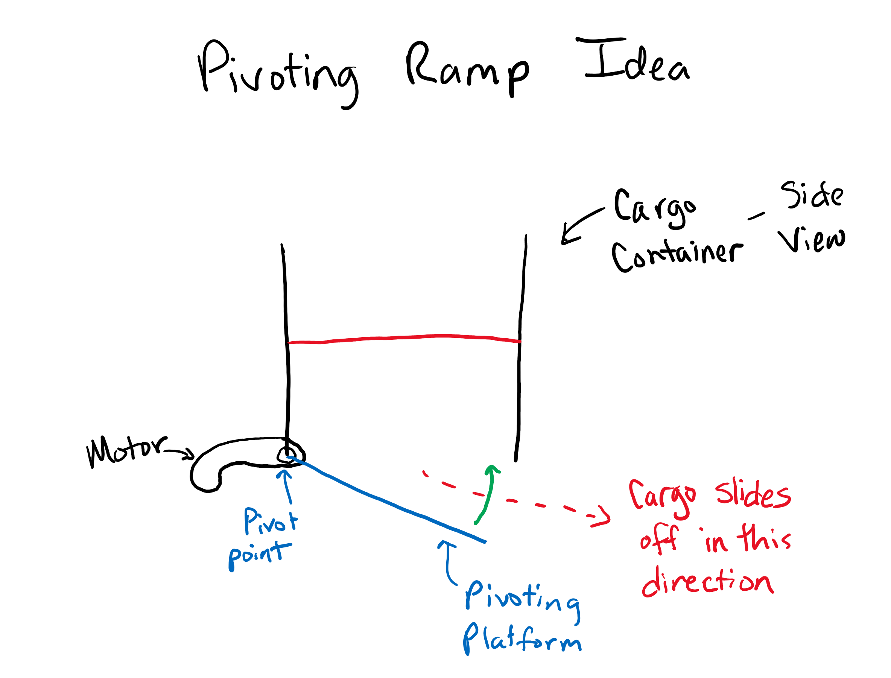
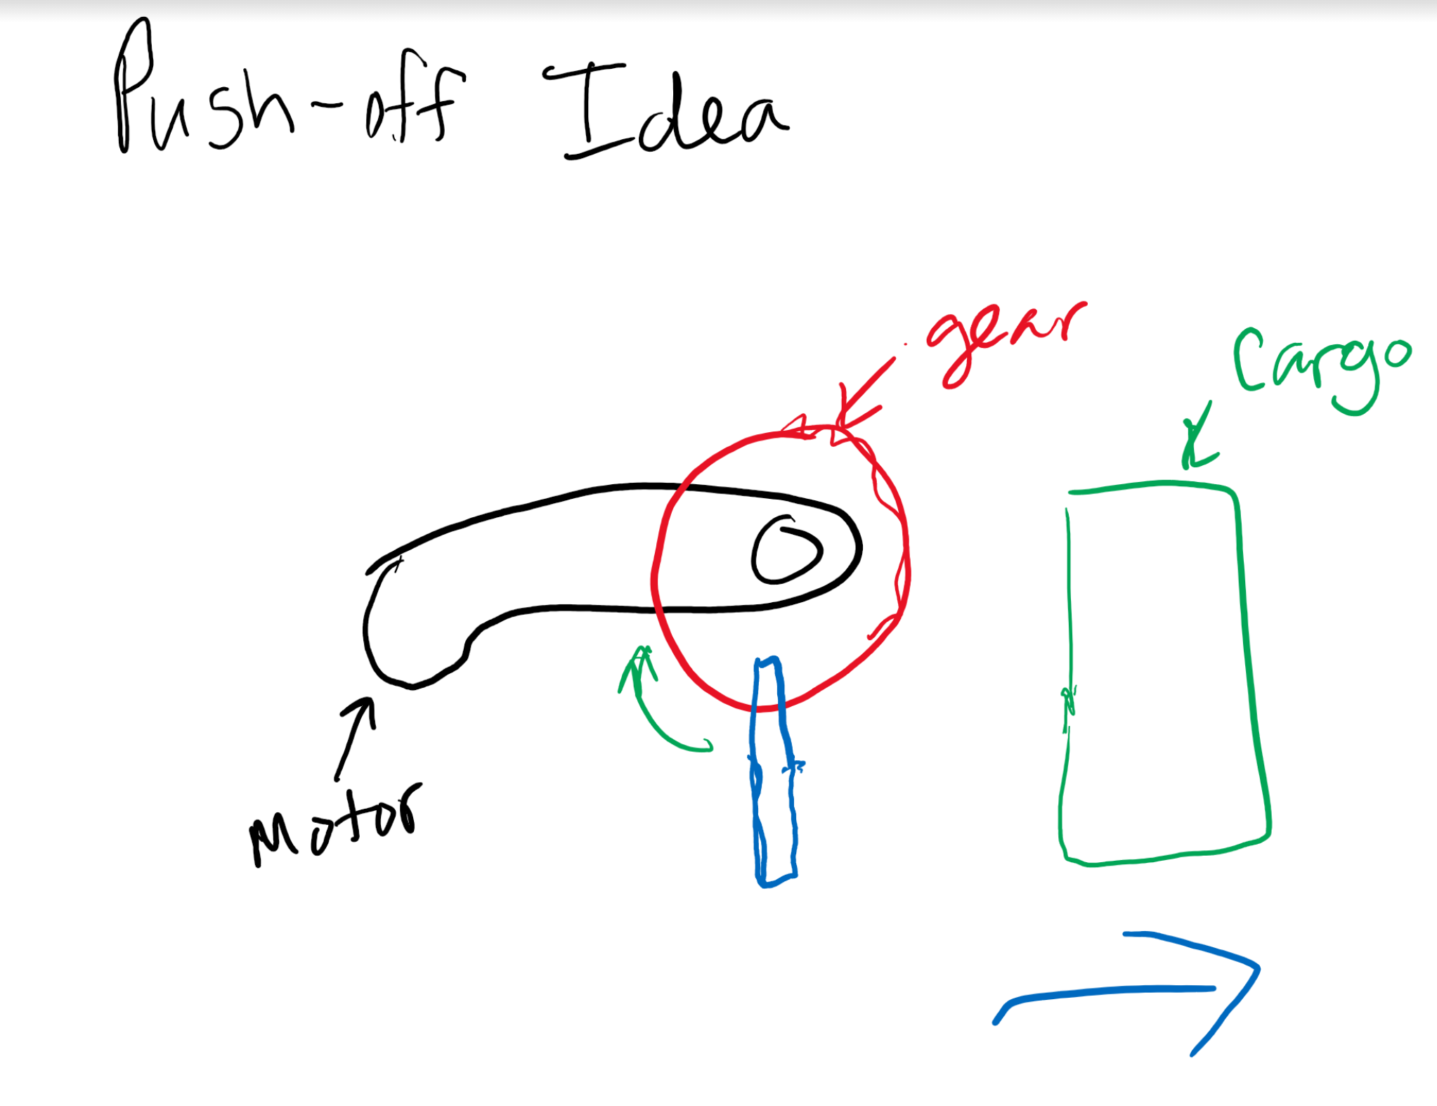
Unloading Mechanism - Brainstorming
Pivoting Ramp
Pushing Mechanism

Slide 9
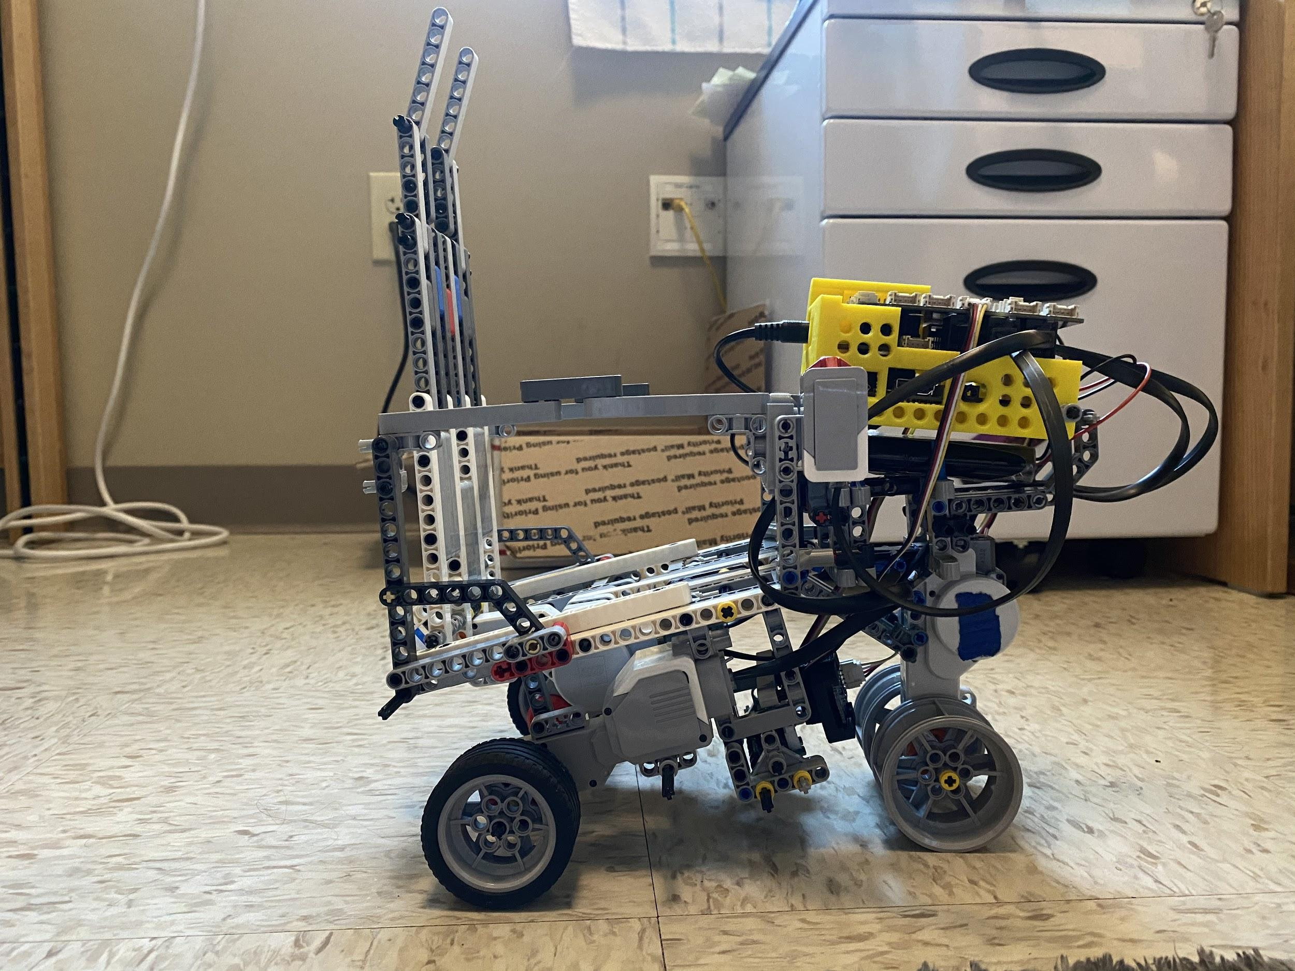
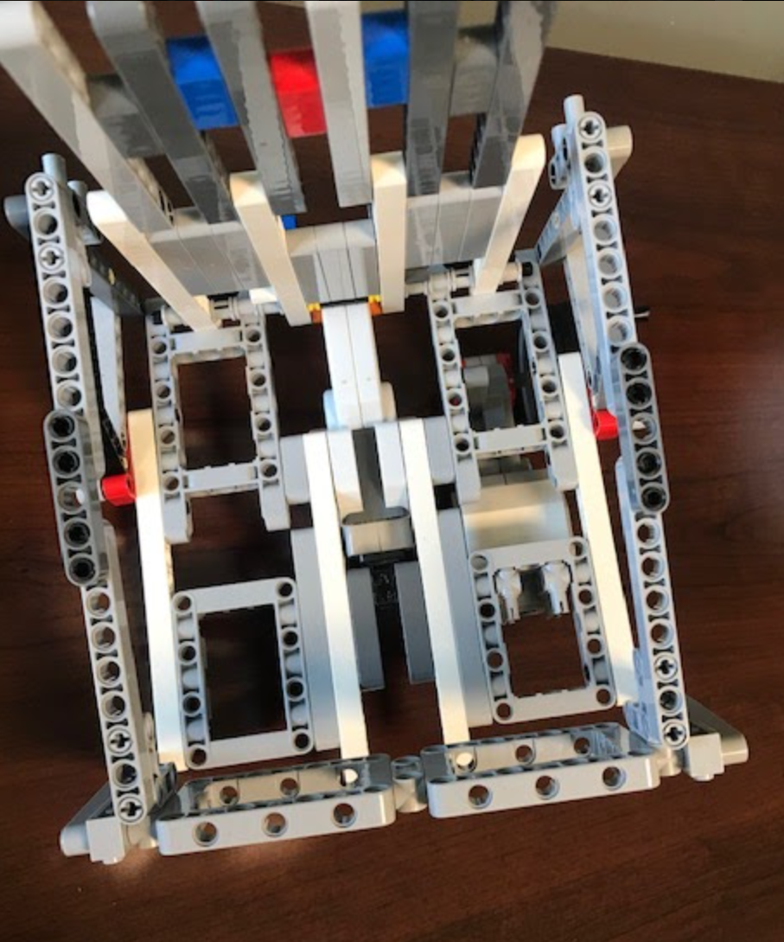
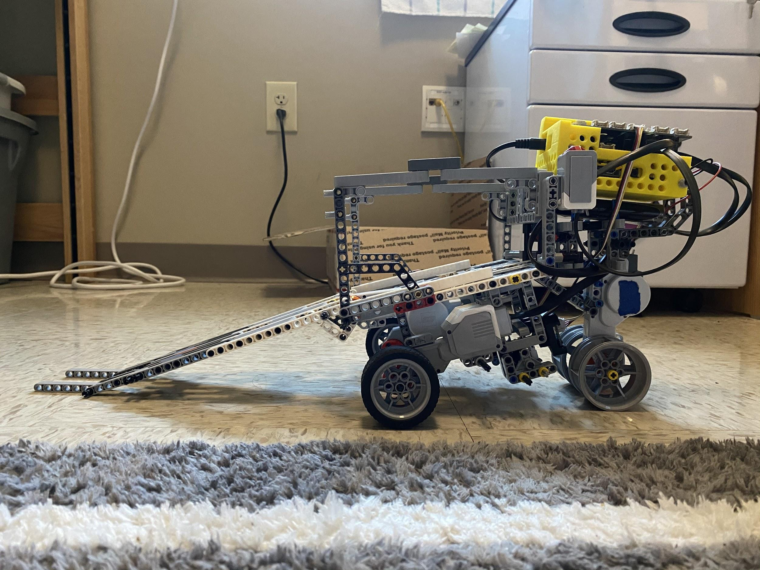
Unloading Mechanism - Final Design
Gate Closed
Platform is a ramp
Door on back
Extends ramp when open
Drive away to unload
Gate Open
Platform

Slide 10
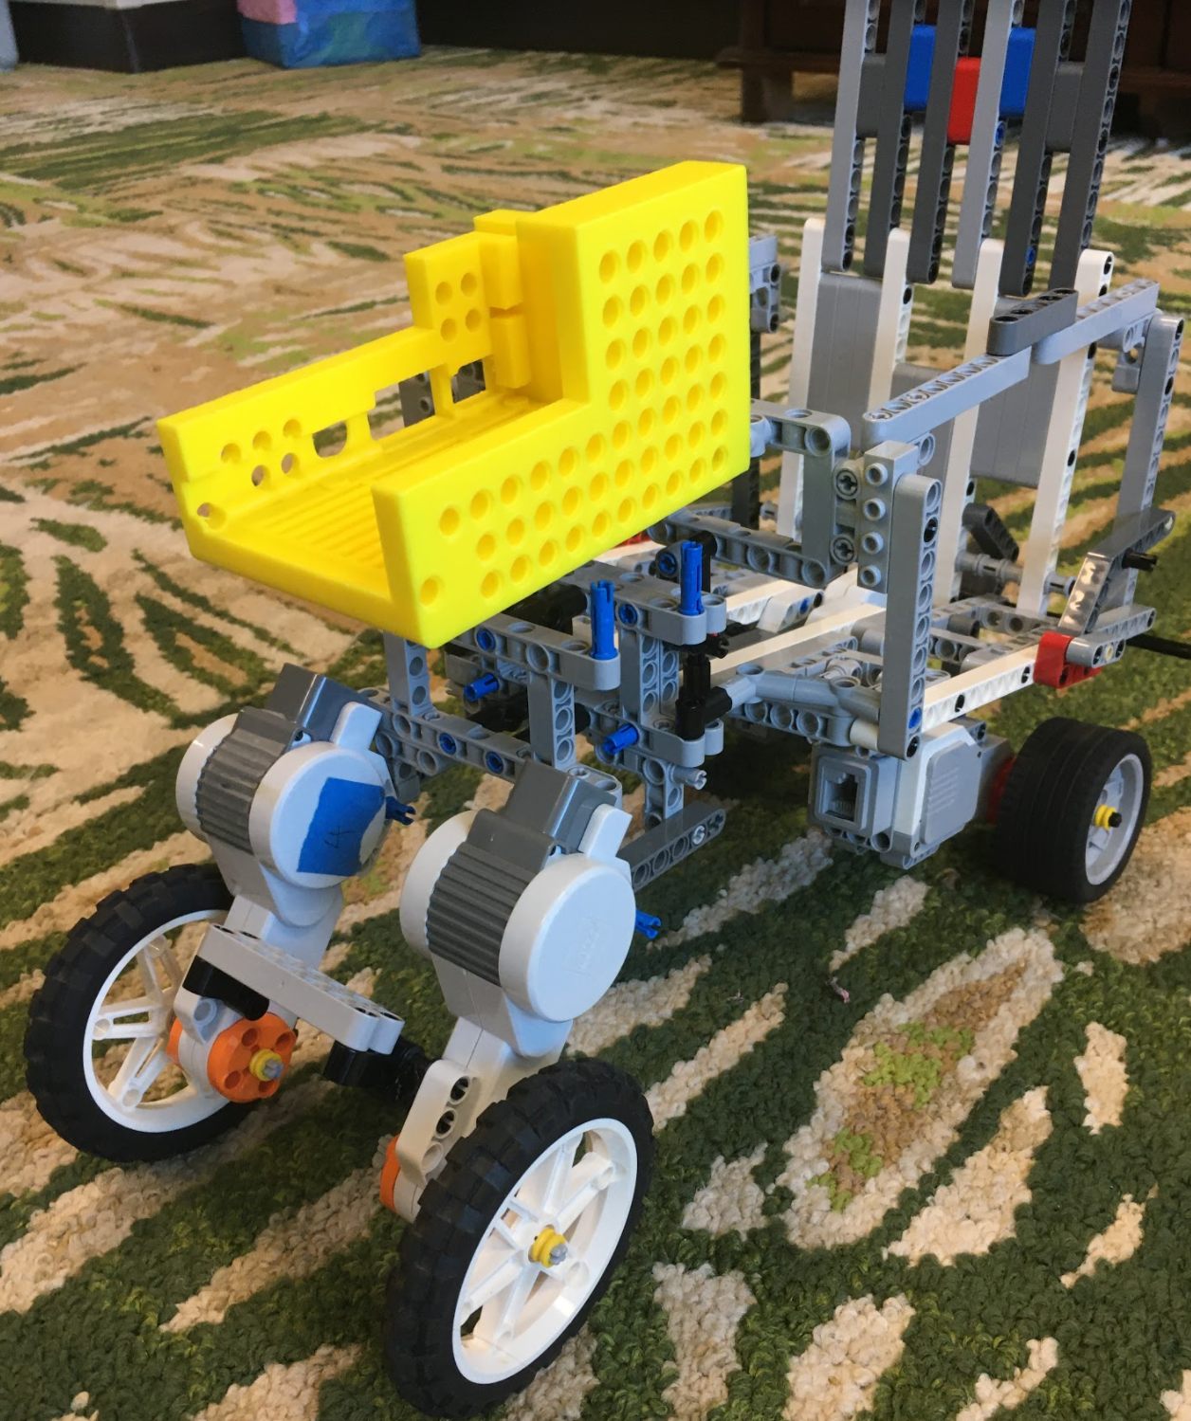
Drivetrain - Initial
Four-wheel drive
Each wheel has its own motor
Large wheels in front
Problems:
Not enough motor ports to power all five motors

Slide 11
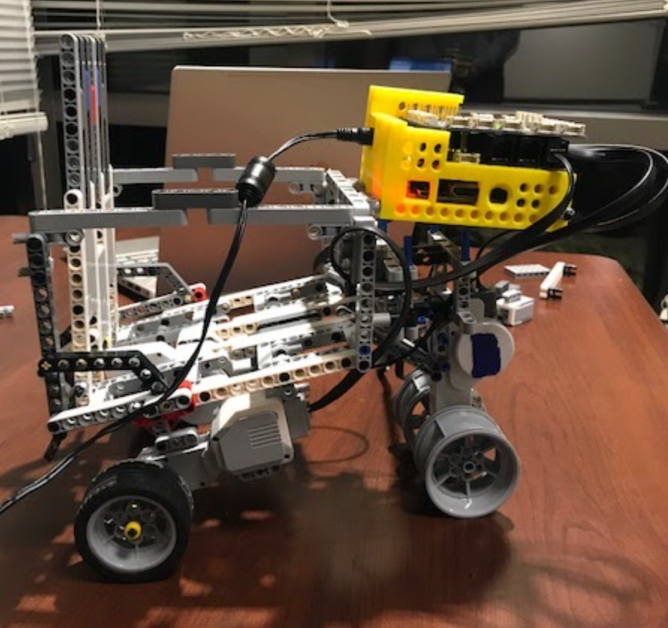
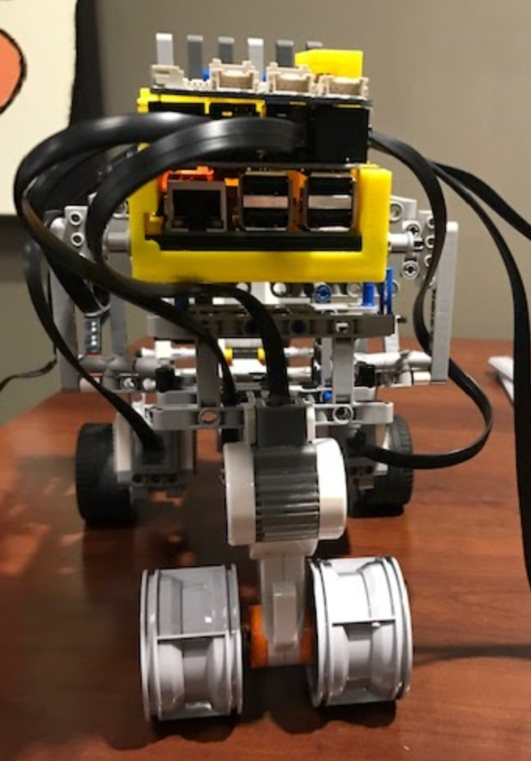
Drivetrain - Final
Three-wheel drive
Two smaller wheels at back
Each with their own motor
With treads on
One thicker wheel in front
Made from two wheels
One motor
No treads

Slide 12
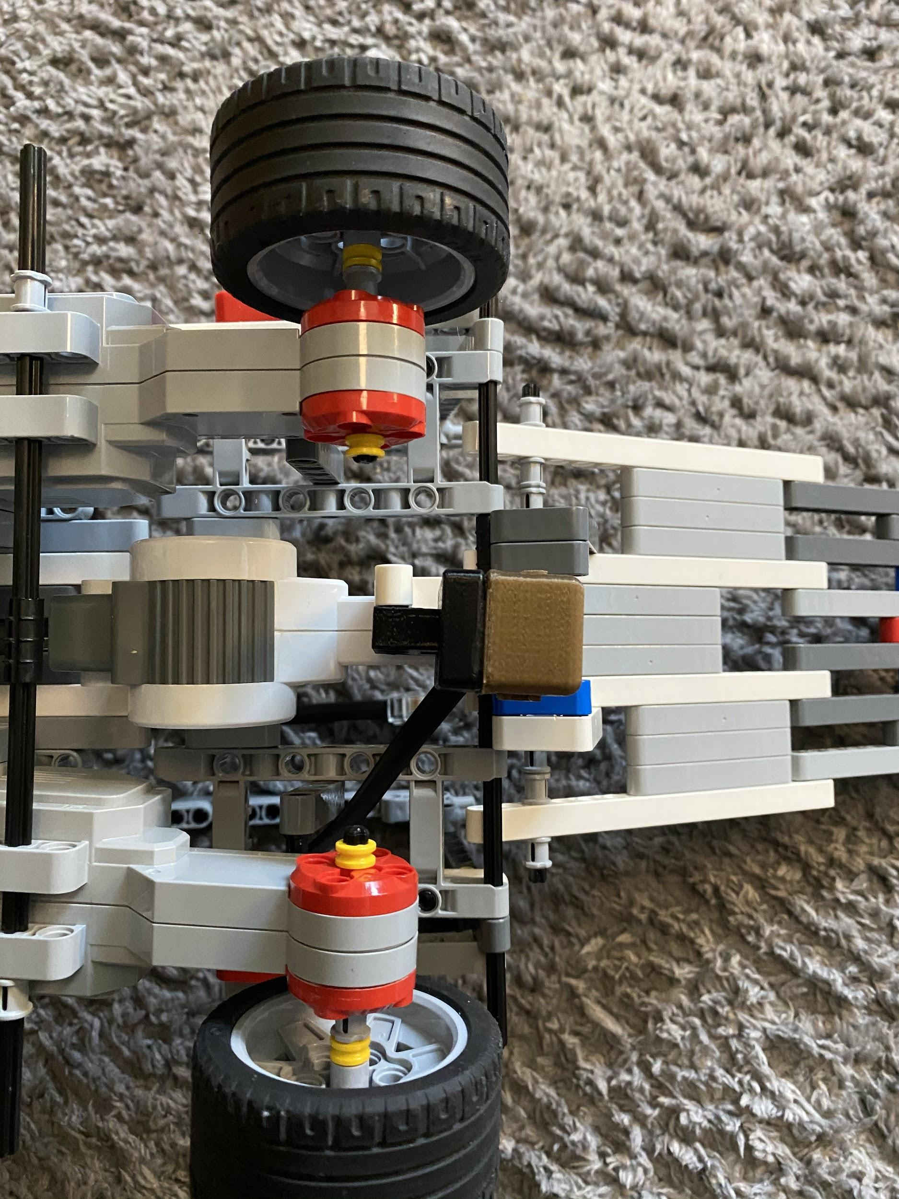
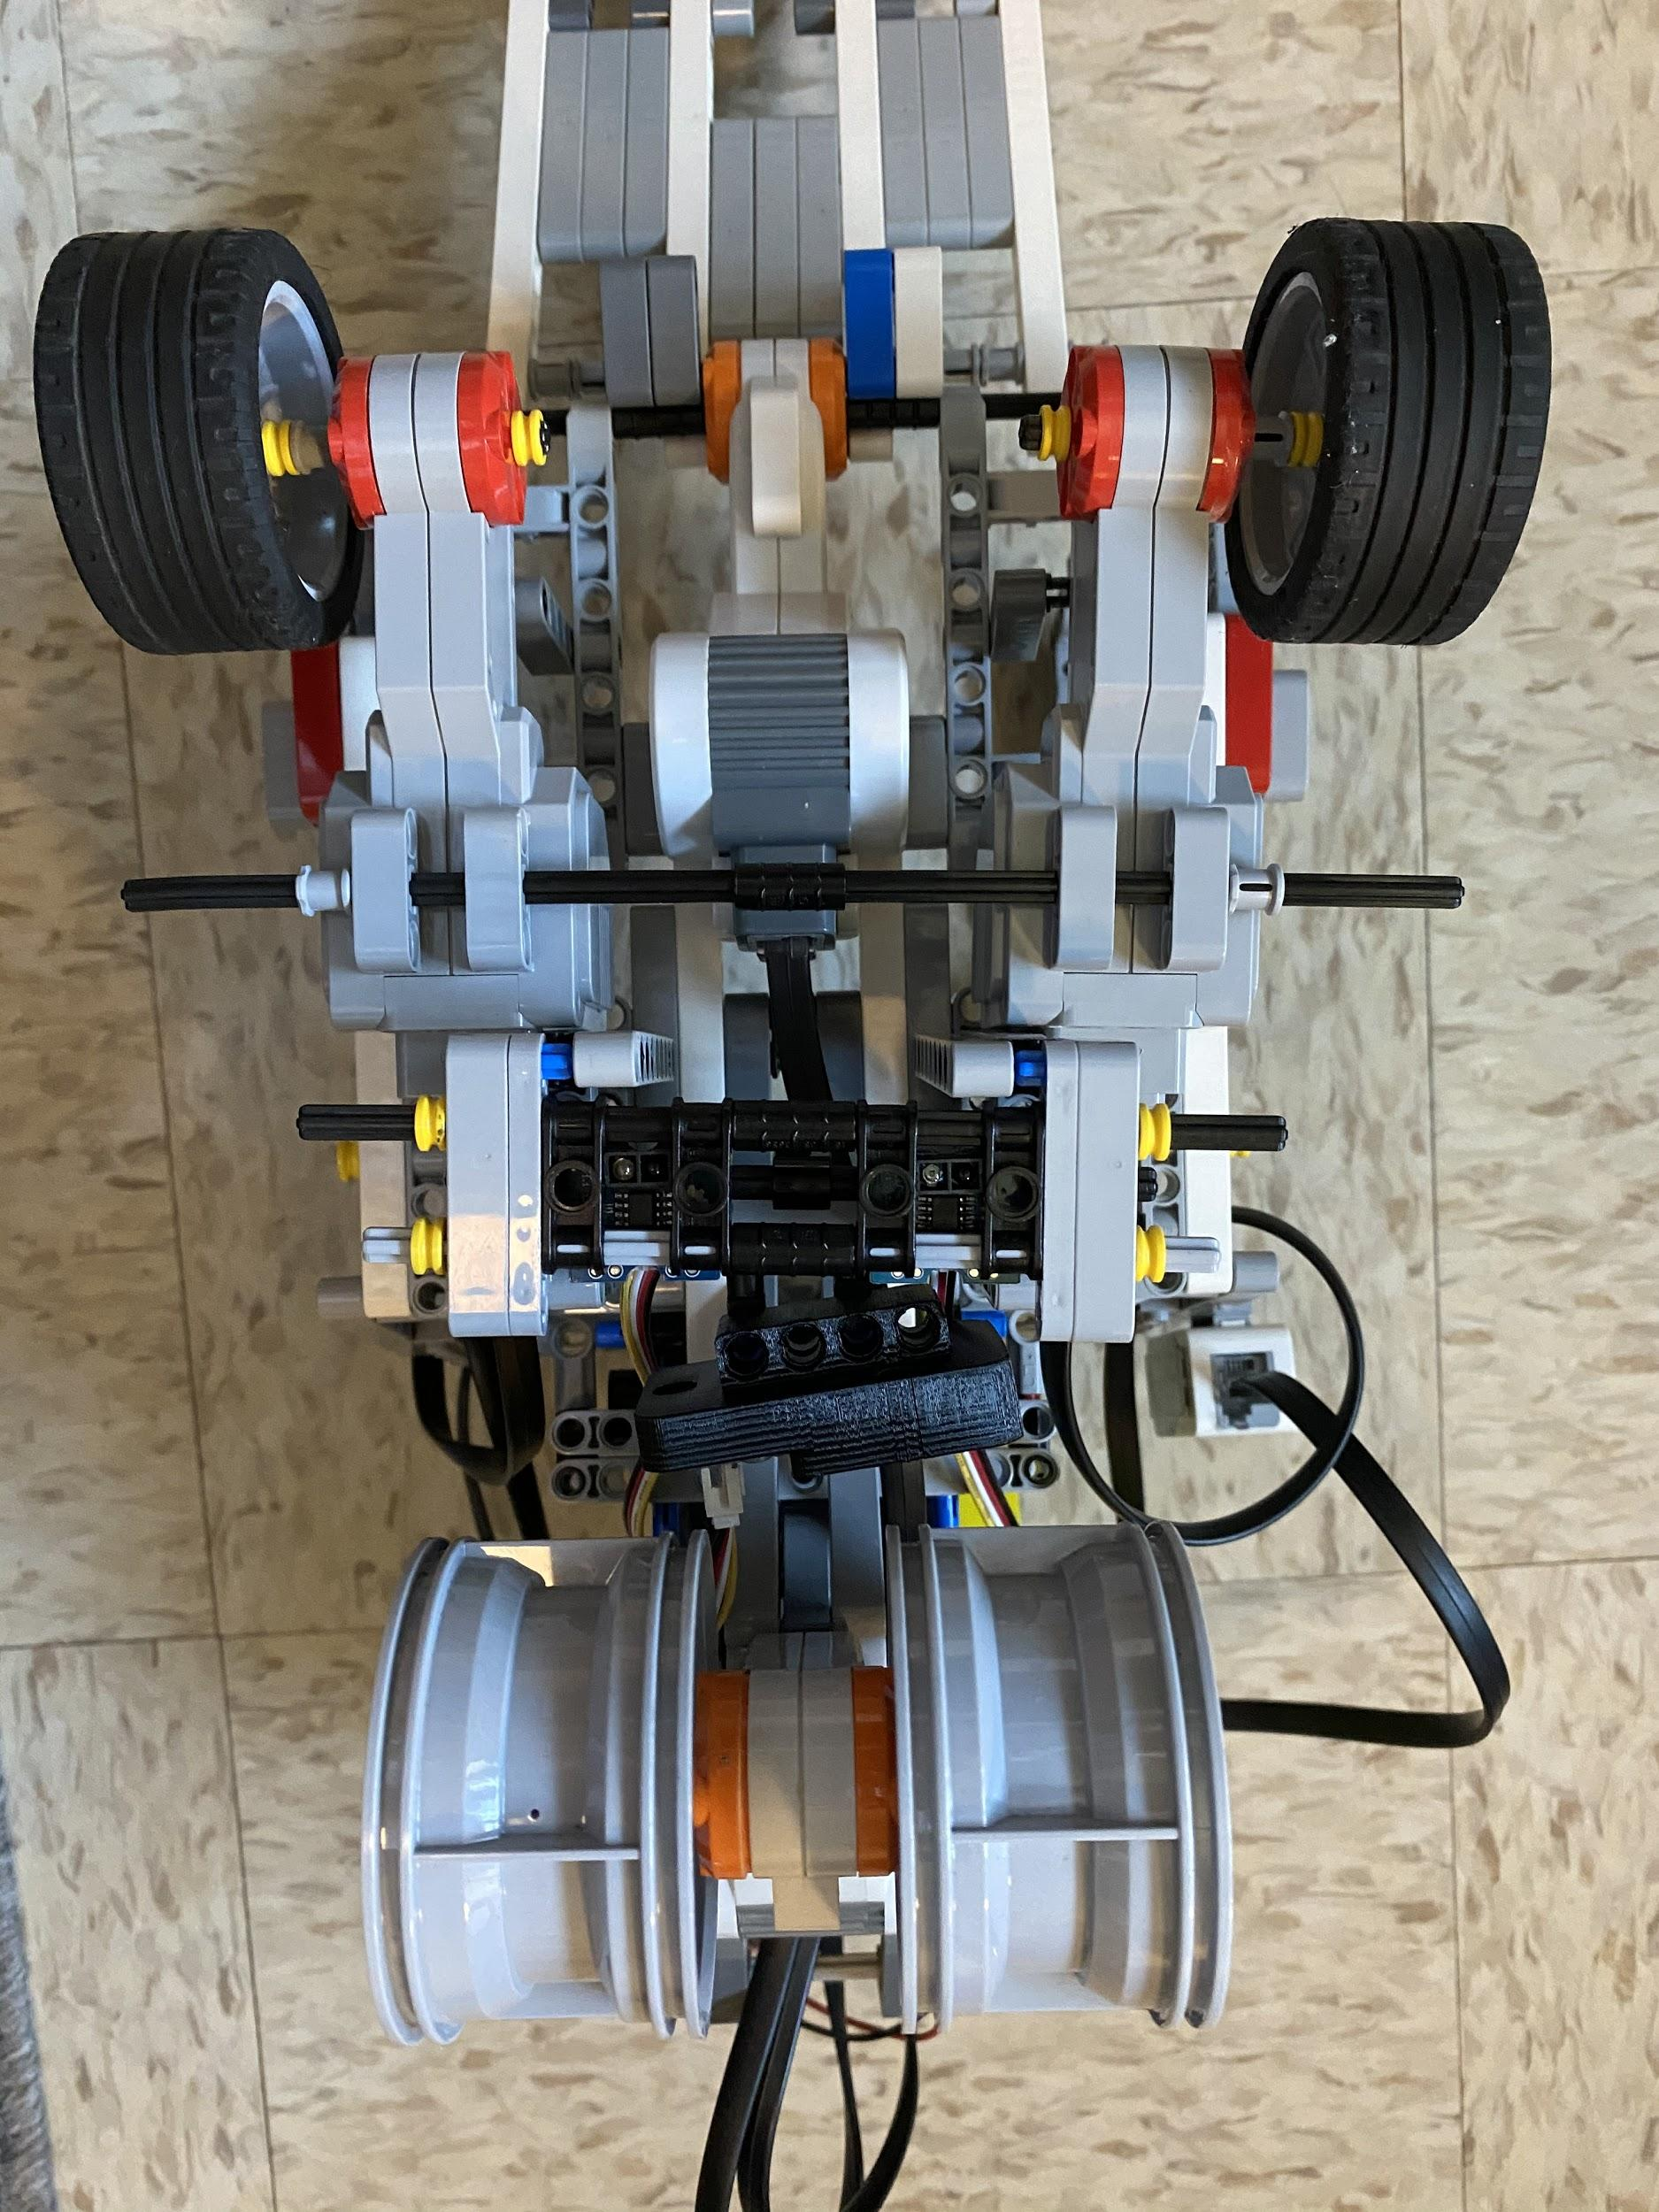
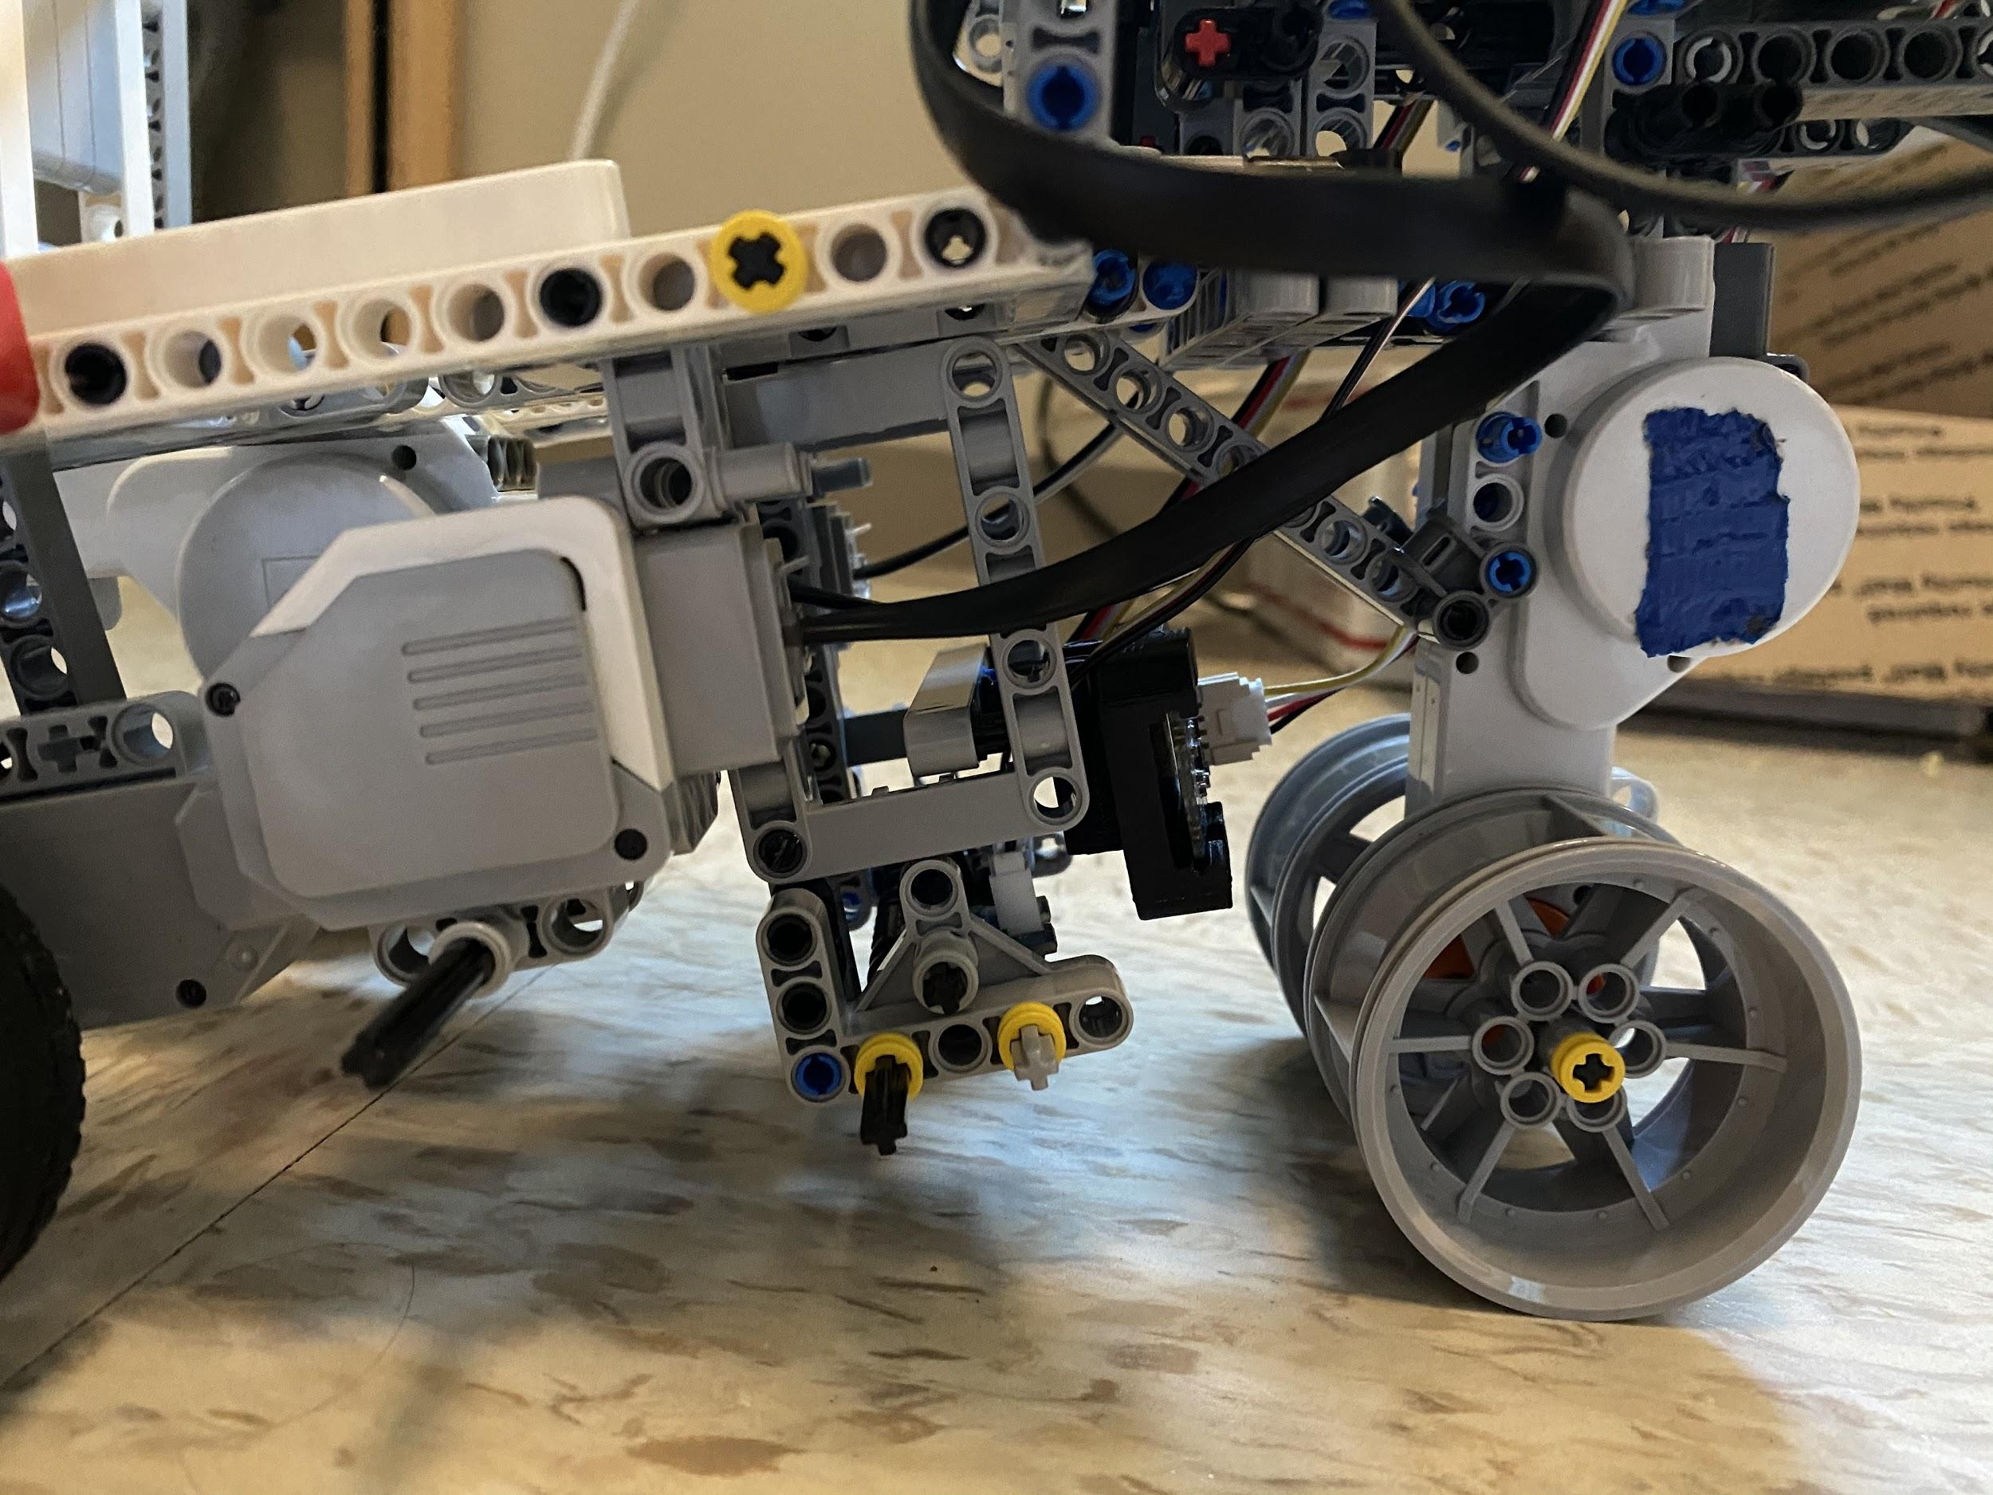
Sensors
Hall Sensor
Line Followers
Line Followers
Near front of MACRO
Behind front wheels
Near ground
Hall Sensor
Under door pivot point
IMU Sensor
Between line followers and front wheels
Near ground
IMU Sensor

Slide 13
Design Philosophy (Software)
Identify basic functions of the MACRO
Breakdown into modules/test individually
Compile code into one main program

Slide 14
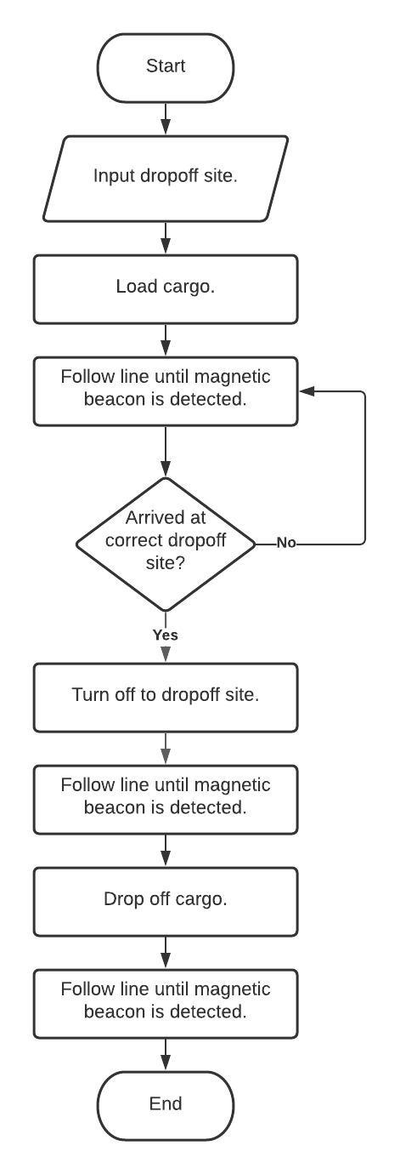
Identifying Basic Functions of the MACRO
The MACRO must be able to do the following:
Accept input for selecting a landing site
Follow the guideline
Detect the magnetic beacon
Turn off at the correct dropoff site
Drop off the cargo
Return to the landing zone.

Slide 15
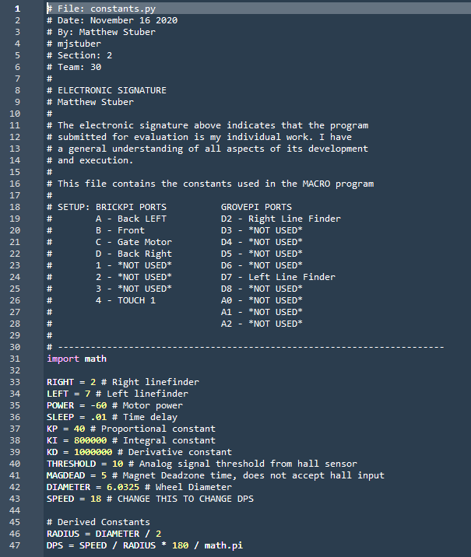
Breaking Down into Modules/Testing Individually
Changes can easily be implemented
Breaking down the code provides clarity and organization.
Individual modules can be used to test discrete aspects of the mission.

Slide 16


Slide 17
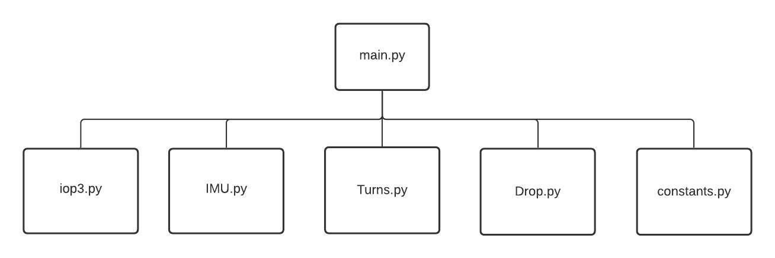
Compiling Code Into One Main Program

Slide 18
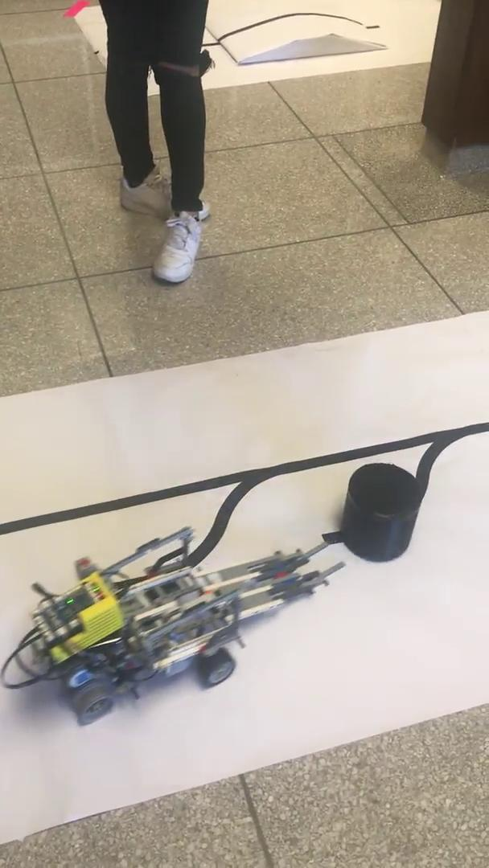
Positive Attributes
Cargo containment
Cargo dropoff
Upright delivery with minimal error

Slide 19
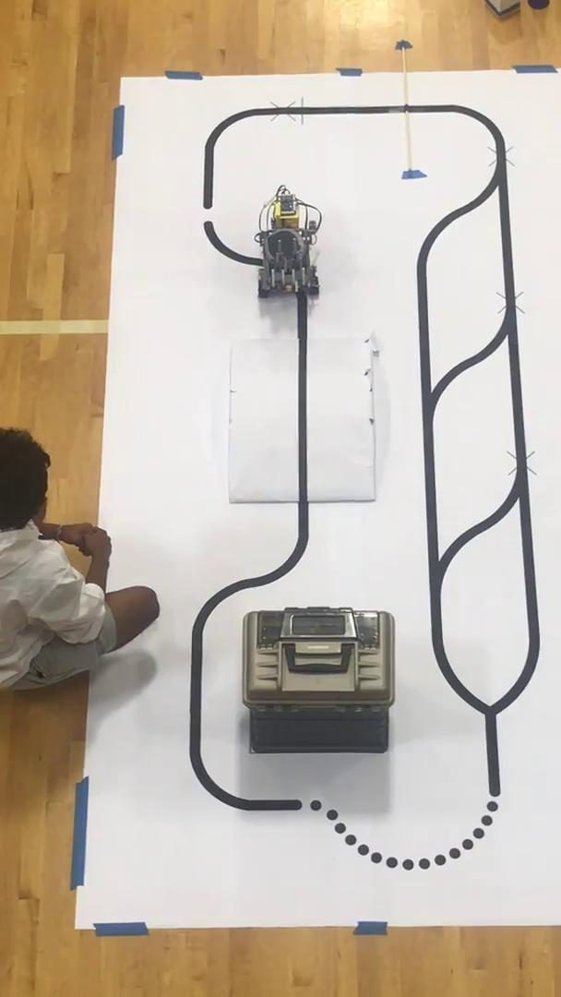
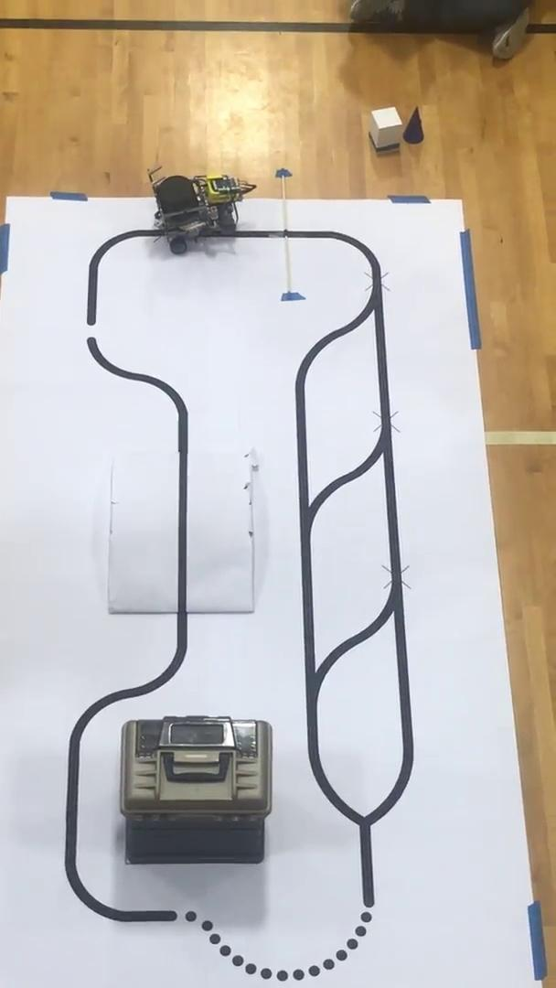
Positive Attributes
Obstacles
Ramp and dowel rod
“Solid” Line Following
Overcorrection
Speed Test

Slide 20
Negative Attributes
“Dashed” Line Following
Overcorrecting over white spaces
Magnet detection
48% success rate
Required Drop site length
≅22 inches minimum
Location of the PI on the robot
Cables had a limited range

Slide 21
Areas for Improvement
Hall sensors
Not sensing the magnets; weak magnetic field and unreliable line following algorithm.
Multiple hall sensors
Lowering the PI closer to the sensors (to allow more freedom in cable lengths and thus placement of sensors)
Lowering the hall sensor so that it can be closer to the magnet and thus have a higher chance at sensing it better.

Slide 22
Areas for Improvement
Line finding:
Unreliable and jerky movements
Inability to make sharp turns or zig-zags; faulty motor and mediocre line following algorithm.
Algorithm that straddles the line more
Accounts for faulty motors and has error catches

Slide 23
Conclusion
Structure and foundation
Strong center of mass
Effective steering/control and acceleration
Design freedom and capability to place sensors anywhere
Resistance to damage and obstacles
Strength to contain cargo
Planning
Can’t predict the future - nothing always goes as planned
Improvisation
Adapt to changes and issue we can’t control

